Slide 1
Introduction to
JavaScript, HTML5, CSS3, jQuery, Twitter Bootstrap, Angular.js
Sources:
www.csee.umbc.edu/~dondim1/104
www.csc.villanova.edu/~map/1020/javascript.ppt
cwo.ucsd.edu/_files/HTML5CSS3-ilin-final.ppt‎‎
csuf.kenytt.net/2012/spring

Slide 2
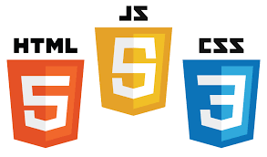
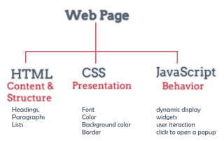

Slide 3
What is JavaScript?
Created by Netscape (~1995)
  Originally called LiveWire then LiveScript
A client-side scripting language
  Client-side refers to the fact that it is executed in the client (software) that the viewer is using. In the case of JavaScript, the client is the browser.
  A server-side language is one that runs on the Web server. Examples: PHP, Python, etc.
Interpreted on-the-fly by the client
  Each line is processed as it loads in the browser

Slide 4
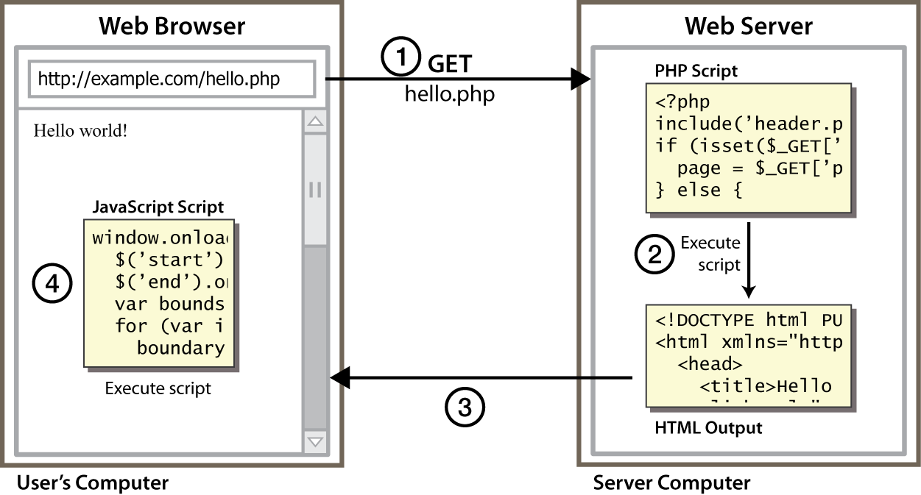
Client and Server Architecture using JavaScript (an Example)
Reference: http://stackoverflow.com/questions/25405966/difference-between-client-api-and-server-api

Slide 5
JavaScript is not Java
Completely different types of languages that just happen to be similarly named
  JavaScript - programs are interpreted in the browser
  Java - programs are compiled and can be run as stand alone applications

Slide 6
Why JavaScript?
It’s easier to learn than most programming languages
It allows you to make interactive Web pages
It can be fun!

Slide 7
What does JavaScript support?
Adding dynamic features to Web pages
  validation of form data
  image rollovers
  time-sensitive or random page elements
Defining programs with Web interfaces
  utilize buttons, text boxes, clickable images, prompts, etc.
Event-driven programming
    specifying actions that are to occur in the page as a result of some event - reacts to events such as mouse clicks, buttons
    Most event-handling is associated with form elements (e.g., button, selection list, radio button, check box, password)

Slide 8
What are limitations of JavaScript?
limitations of client-side scripting
  since script code is embedded in the page, it is viewable to the world
  for security reasons, scripts are limited in what they can do
    e.g., can't access the client's hard drive
  since they are designed to run on any machine platform, scripts do not contain platform specific commands
  script languages are not full-featured
    e.g., JavaScript objects are very crude, not good for large project development

Slide 9
Including JavaScript in HTML
add JavaScript to Web pages
  Use the <script>…</script> tag
<!DOCTYPE html>
<html>
<head>
<title>Hello World Example</title>
</head>
<body>
<script type="text/javascript">
<!--
document.write("<h1>Hello, world!</h1>");
//-->
</script>
</body>
</html>

Slide 10
HTML5 is more than HTML5
HTML5 Spec
CSS3 Spec
Web Fonts
JavaScript to tie it all together

Slide 11
What’s New in HTML5 Spec?
Simplified and Loose Syntax
New Elements and Attributes
Embedded Media
Canvas
Offline Storage
Drag and Drop
Geo-Location
Local Database

Slide 12
Why Use HTML5 Today?
Pros
  Better semantics
  Lean code
  Improved user experience
Cons
  Some work is needed to accommodate older browsers

Slide 13
What’s New in CSS3 Spec?
New Selector (http://www.w3schools.com/cssref/css_selectors.asp)
Decorations (http://www.w3schools.com/cssref/pr_text_text-decoration.asp)
New Column Layout (http://dev.w3.org/csswg/css-multicol/Overview.src.html)
Transformation (Rotate, Resize… etc.) (http://www.w3schools.com/css3/css3_2dtransforms.asp)
Animation (Fade In/Fade Out) (http://www.w3schools.com/css3/css3_animations.asp)

Slide 14
Why Use CSS3 Today?
Pro
  Smaller download
  Less JavaScript
  Better user experience
Cons
  Some work is needed to accommodate older browsers

Slide 15
jQuery
jQuery is free, open source software (2006)
A cross-platform JavaScript library designed to simplify the client-side scripting of HTML.
the most popular JavaScript library in use today, with installation on 65% of the top 10 million highest-trafficked sites on the Web
jQuery is a lightweight JavaScript library that emphasizes interaction between JavaScript and HTML.
jQuery features:
  HTML element selections/manipulation
  CSS manipulation
  HTML event functions
  JavaScript effects and animations
  HTML DOM traversal and modification (Document Object Model)
  AJAX (Asynchronous JavaScript and XML)
  Utilities

Slide 16
Why jQuery?
jQuery is the defacto standard javascript library.
It works across most browser platforms.
  Rich Internet Applications (RIA)
  Dynamic HTML (DHTML)
Advantages over just JavaScript
  Much easier to use
  Eliminates cross-browser problems
helps compliment Bootstrap’s built-in functionality well.
  Datatables – to display tabular data
  jqPlot – to display graphs
  jQuery Validation – to validate form input

Slide 17
Twitter Bootstrap
Bootstrap is a front end framework, that is, an interface for creating websites and web applications.
It aims to ease the development of dynamic websites and web applications.
Very easy to use and based on latest Web Development Standards for screen and form design (contains HTML- and CSS-based design templates for typography, forms, buttons, navigation and other interface components, optional JavaScript extensions)
Very lightweight – it can be as little as just one CSS and one JS file.

Slide 18
Why Twitter Bootstrap?
Easy to create a layout – content only, left menu + content, right menu + content, etc.
Beautiful and functional built-in components which are easy to customise
Built-in Javascript to support components
Very low learning curve
Works well with jQuery and other javascript libraries

Slide 19
What is AngularJS?
Developed and maintained by Google
It is one of the top 3 JavaScript Frameworks.
It provides set of components to structure your app and organize the project.
Made for ambitious JavaScript Single Page Applications
It provides tools to make life of Frontend Developers easier by providing set of guidelines and architecture to application.

Slide 20
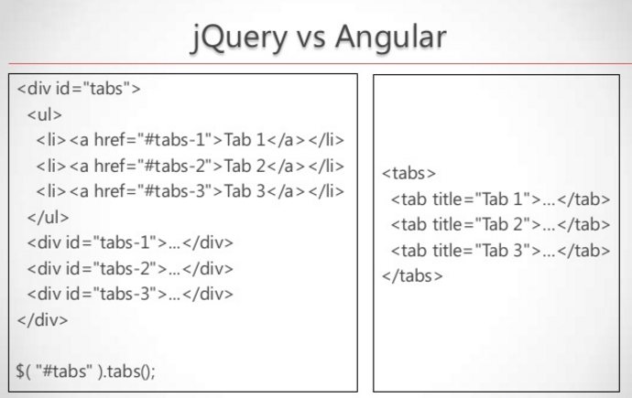

Slide 21
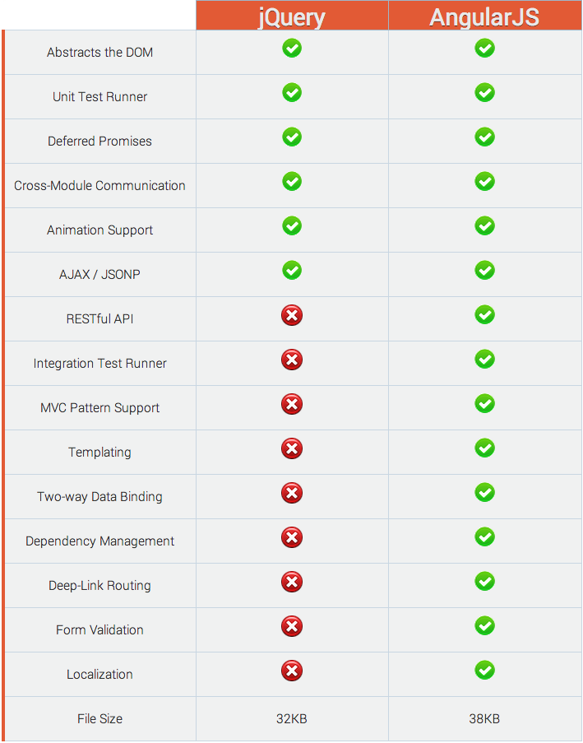
jQuery vs. AngularJS: A Comparison
https://www.airpair.com/angularjs/posts/jquery-angularjs-comparison-migration-walkthrough

